Slide 1


Measure polarization in potassium isotopes
Dante Prins
TRIUMF TRINAT

Slide 2
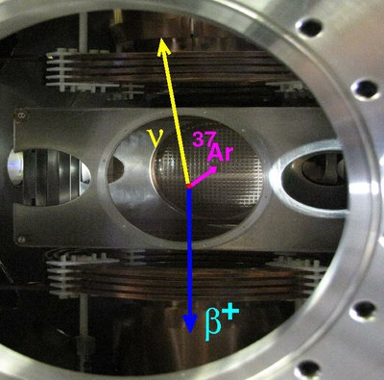
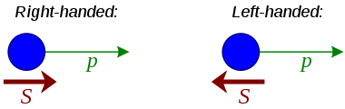

Potassium 37 beta decay asymmetry experiment
Beta decay is known to violate parity symmetry, having a chirality dependance and a bias for left handedness. Our experiment polarized the parent atom and measures beta emission direction.
0nm
Notes:
Beta decay asymmetry polarization probing needs 405nm light

Slide 3

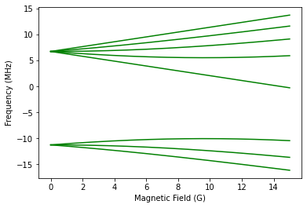


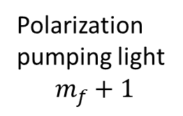





Polarization measurement
Zeeman effect at medium magnetic fields
In the presence of a magnetic field energies will shift allowing us to probe individual polarizations.
5p1/2
Zeeman effect splitting for 5p1/2 K41
Probe light tuned to hyperfine polarization.
405nm
$m_{f}$= 2
$m_{f}$= 1
F=2
$m_{f}$= 0
$m_{f}$= -1
4p1/2
$m_{f}$= -2
770nm
Polarization pumping light
$$m_{f}+1$$
F=1
$m_{f}$= -1
4s1/2
$m_{f}$= 0
$m_{f}$= 1

Slide 4
↕ means up/down regardless of beam direction.
↔ means left/right regardless of beam direction.
To Wavemeter
laser
↕
PBS
↕
λ/2
↔
↔
To atom trap
↕
BS
Photo darkening resistant FC/AFC fiber
AOM
Zeeman dither solenoid
PBS
λ/4
Probe light
λ/4
↔
BS
↕
↻
↻
↺
↺
↕
↔
Pump light
↔
Potassium vapor
λ/4
λ/2
To laser lock
↕
↕
↻
Notes:
↑ ← → ↻ ↔ ↕ ↺

Slide 5
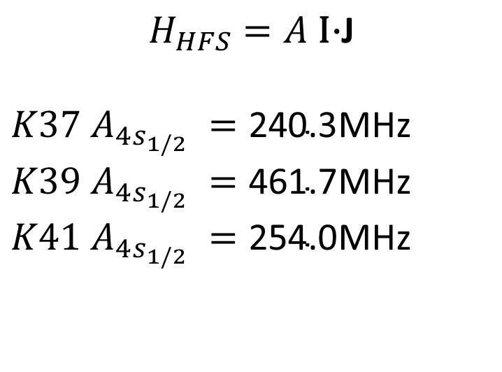
Hyperfine structure splitting varies by isotope
Isotope | Abundance
K37 | 1.23s half life
K39 | 93%
K41 | 7%
$$H_{HFS}=A \text{I}\text{⋅}\text{J}$$
${K37 A}_{4s_{1/2} }=\text{240.3}$MHz
${K39 A}_{4s_{1/2} }=\text{461.7}$MHz
${K41 A}_{4s_{1/2} }=\text{254.0}$MHz
How do we lock the trap to K39 spectra but scan K37?

Slide 6
Isotope frequency shift is corrected by Acousto-Optical Modulator
Picture of aom module
Feedback signal
Power detector
Potassium cell
K39
Current and voltage control
+2x150MHz
Double pass Acousto-Optical Modulator
K41
Laser
Atom trap
405nm light
K37

Slide 7
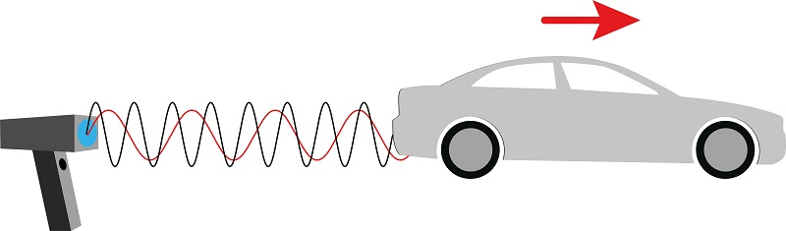


Acousto-Optical Modulator physics
Diffracted wave gets frequency boost
$$θ$$
$$θ$$
The incoming light is Doppler shifted to a higher frequency in the reference frame of the moving Bragg plane before being diffracted.
Sound wave in crystal

Slide 8
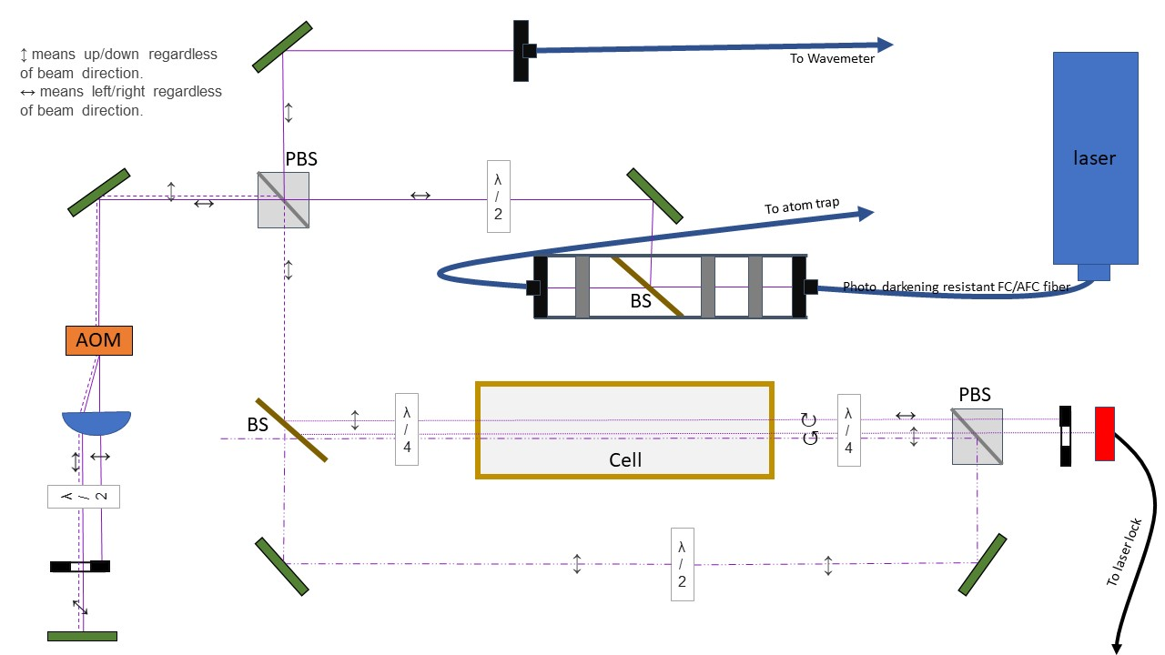
Beam polarization
Notes:
We skip this for sake of time

Slide 9
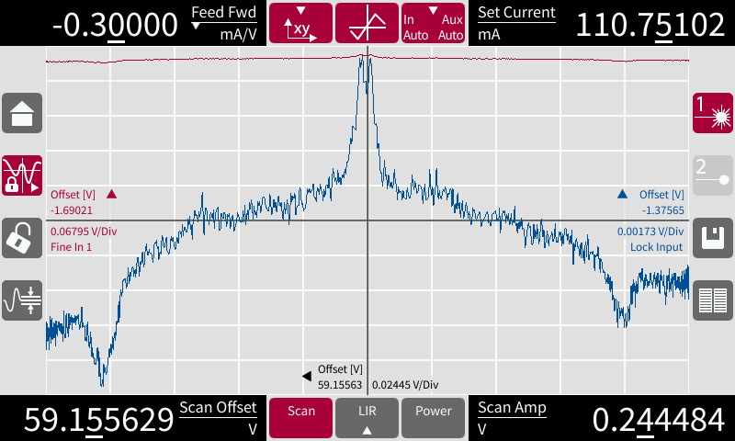
K cell sat spectroscopy
We know the cell will absorb light at transitions frequencies, how do we arrive at the actual absorption signal?
decreasing absorption (increasing power)
Potassium cell
Probe beam
Pump beam
Increasing frequency
Notes:
okay now that we have the right wavelength lets understand how this lets us lock the laser, first lets consider only the incoming beam. K atoms absorb the light as transitions to the 5p1/2 at an increased polarization due to the spin momentum of the light

Slide 10
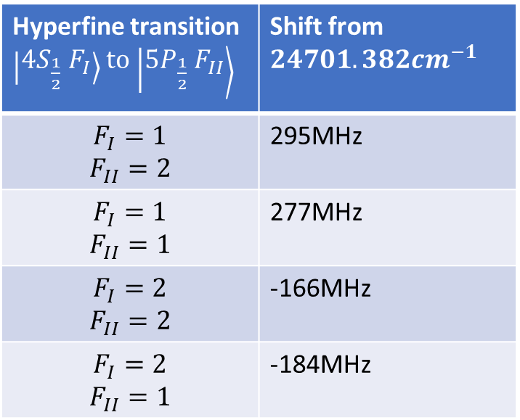






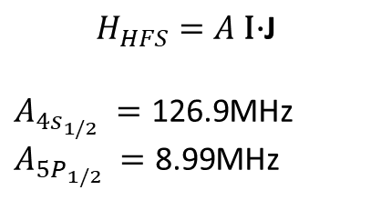
Hyperfine structure frequencies for K39
$$F=2$$
Hyperfine transition $\left|4S_{\frac{1}{2}} F_{I}\right\rangle$ to $\left|5P_{\frac{1}{2}} F_{II}\right\rangle$ | Shift from $24701.382{cm}^{−1}$
$$F_{I}=1$$ $$F_{II}=2$$ | 295MHz
$$F_{I}=1$$ $$F_{II}=1$$ | 277MHz
$$F_{I}=2$$ $$F_{II}=2$$ | -166MHz
$$F_{I}=2$$ $$F_{II}=1$$ | -184MHz
$$5P_{1/2}$$
18MHz
$$F=1$$
740THz
$$F=2$$
$$4S_{1/2}$$
254MHz
$$H_{HFS}=A \text{I}\text{⋅}\text{J}$$
$A_{4s_{1/2} }=\text{126.9}$MHz
$A_{5P_{1/2} }=\text{8.99}$MHz
$$F=1$$

Slide 11
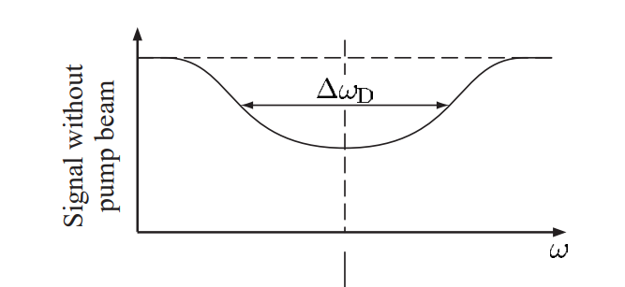
Doppler shift broadened absorption
Decreasing absorption (increasing power)
‘Atomic Physics’ by Foot.

Slide 12
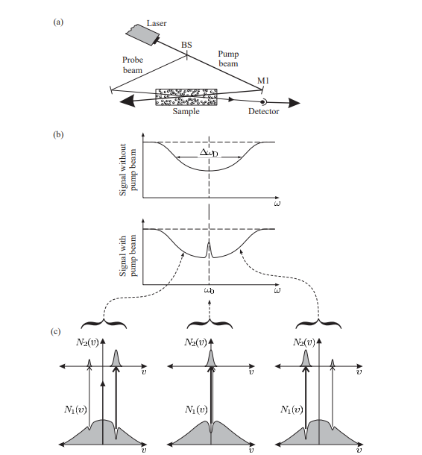
Pump beam hole burning
Now that our absorptions are Doppler smeared, we use the pump beam to select atoms with zero velocity.
Increasing power (decreasing absorption)
4s F=2
4s F=1
Increasing frequency
‘Atomic Physics’ by Foot.

Slide 13
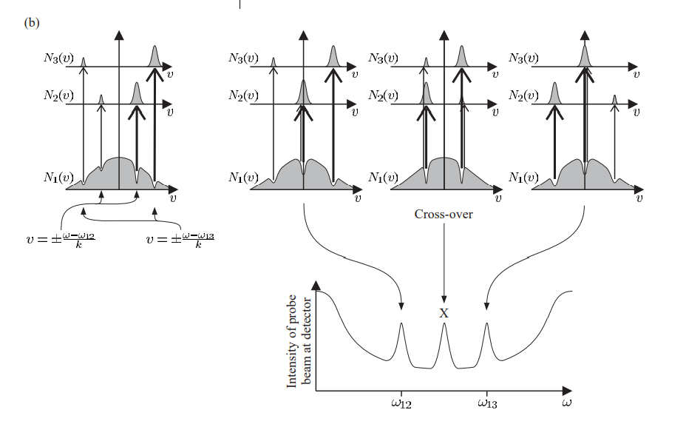
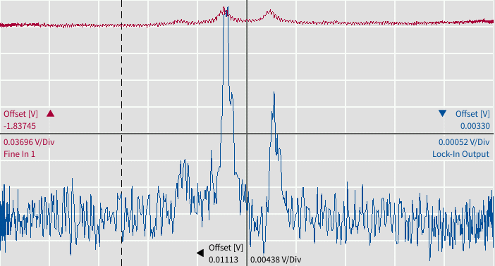
Crossover effect
Every pair of peaks has a composite peak halfway in between from the doppler shifts of the two side peaks.
Increasing power (decreasing absorption)
Increasing frequency
‘Atomic Physics’ by Foot.

Slide 14
Enhanced absorption
Increasing power (decreasing absorption)
Increasing frequency

Slide 15
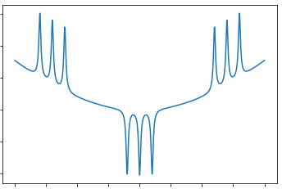


Enhanced absorption
Because the two Doppler crossed frequencies start from different hyperfine ground states the pump does not steal from the probe.
Instead, the pump beam states randomly decay towards the opposing hyperfine, increasing the population the probe sees.
Increasing power (decreasing absorption)
2->1
1->2
2->2
1->1 + 2->1
1->1
$$−∆f$$
$$+∆f$$
Increasing frequency

Slide 16
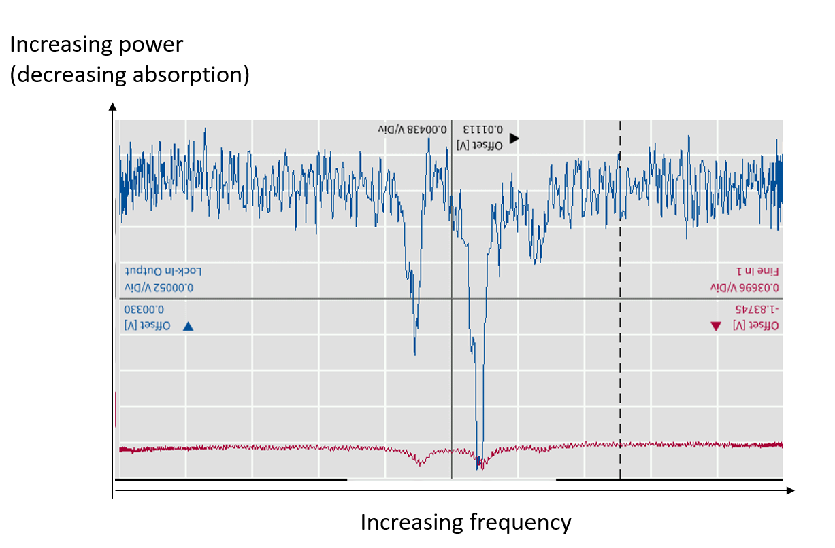
Enhanced absorption
Atoms moving towards the probe beam absorb the pump beam in the 1->1 transition, which randomly decays, populating the F=2 ground state for the probe beam which is absorbed in the 2->1 transition.
Increasing power (decreasing absorption)
2->1
1->2
2->2
1->1 + 2->1
1->1
Atoms moving away from the probe beam absorb the pump beam in the 2->1 transition, which randomly decays, populating the F=1 ground state for the probe beam which is absorbed in the 1->2 transition.
$$−∆f$$
$$+∆f$$
Increasing frequency

Slide 17
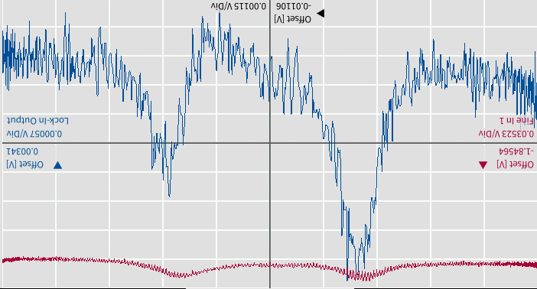
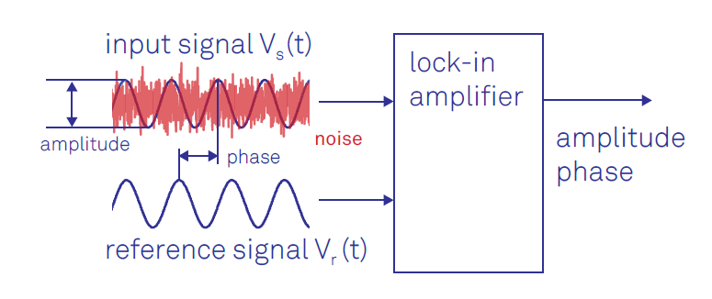
Locking the laser frequency using absorption peaks
Using a solenoid and the Zeeman effect to produce slight high-frequency energy oscillations in the cell, correlating absorption peaks to our magnetic scan we can produce a cleaner signal and lock to the peak with a Proportional Integral Derivative control loop.
Raw absorption signal
Lockin Detector ‘cleaned signal’

Slide 18
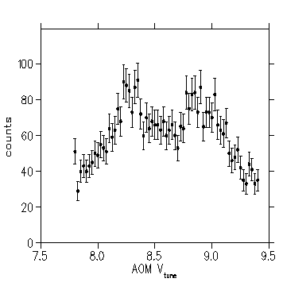
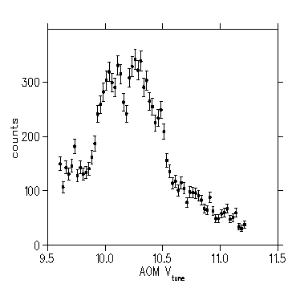
Very early data
K41 2->1 and 2->2 absorptions
K41 1->1 and 1->2 absorptions

Slide 19
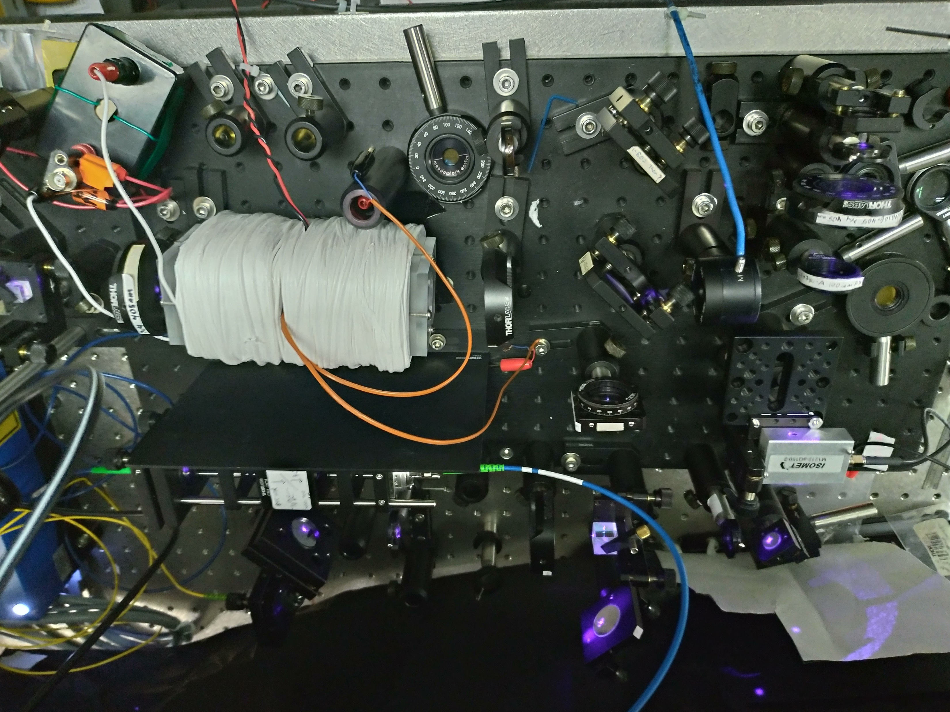
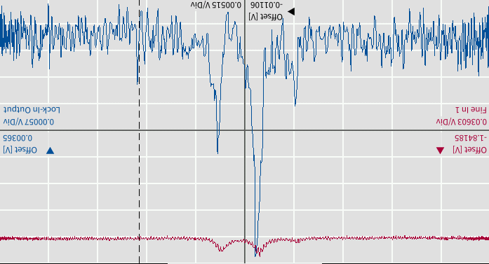
Thank you!

